Slide 1

NFL and College Football Data Analysis

Slide 2
Catalog
Introduction
Data
Analysis
Linear Regression
Clustering
Conclusion

Slide 3

Introduction
As the most popular sport in the United States, football draws numerous attention from American people. We want to find out what football game statistics have more influence on game results and predict the performance of football teams in future seasons.
Therefore, we first pick the number of predictors that has significant influence on game result using subset selection. We then compared the models suggested by best subset selection and penalized regression (LASSO). With these predictors and data from 2000 season to 2013 season, we train a linear regression model and test it with cross-validation to estimate our mean squared prediction error.
Then, we utilize PCA (principle component analysis) to reduce the dimension of our model to only two PC -values. Afterwards, we impalement K-Means clustering using the PC -values obtained above to generate 2 clusters. One cluster contains teams that have great possibility to qualify the playoffs and the other cluster contains teams that are not likely to qualify the playoffs.
We also test our clustering model on the data of 2013 season and find the result greatly fits the reality.

Slide 4
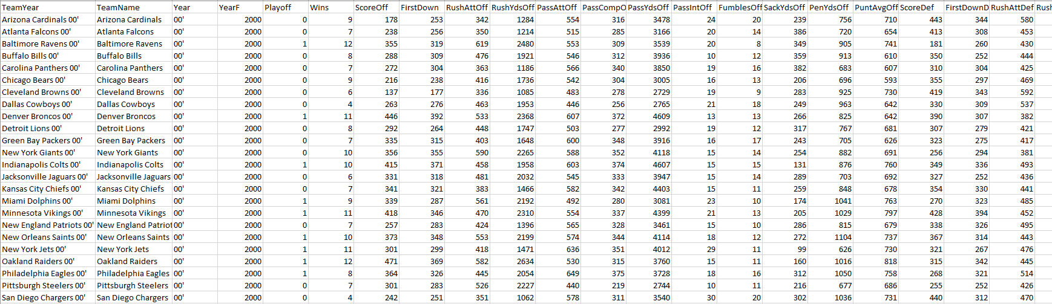
Data
Data used: NFL and College Football cumulative statistics and regular season data from 2000 to 2013
Data Processing:
For a specific team, sum up its statistics in that single season.
Put the data of every team from every season into one csv file and named it nfl_all_data and cfc_all_data. For the nfl_all_data, add another column with 1 represents that team made to the playoff that season and 0 represents the team didn’t make it and name it as nfl_playoff_all_data.
Sample data (nfl_playoff_all_data) shown below.

Slide 5
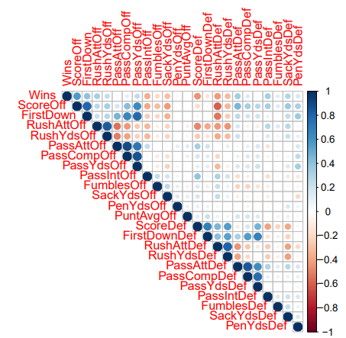
Analysis – Linear Regression
We plot the correlation graph of our 23 potential predictors to check if there’s possible highly related predictor.
Most of the predictors look in shape, so we will keep all predictors for further subset selection process.
NFL Predictors Correlation

Slide 6
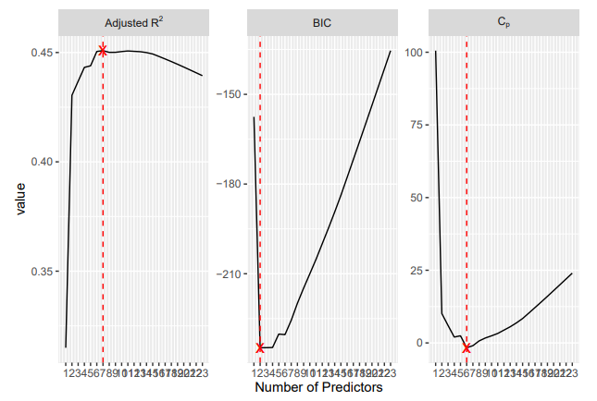
Analysis – Linear Regression
Use the regsubsets function to perform best subset selection in order to choose the best model containing our 23 predictors according to Cp, BIC, and adjusted R2.
The best subset method yields a result of 7 best predictors: ScoreOff, RushAttOff, RushYdsOff, ScoreDef, RushYdsDef, PassAttDef, FumblesDef.

Slide 7
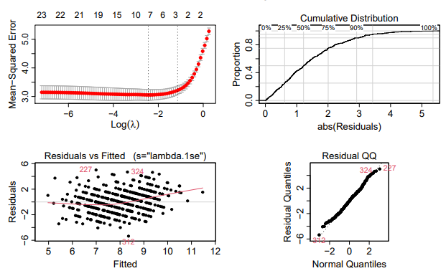
Analysis – LASSO
For the sake of space, we only show the result of LASSO instead of the linear regression model.
The LASSO Regression yields a optimal lambda of 0.08683439 and gives the following model with also 7 variables: Wins = 5.84 + 0.0134ScoreOff + 0.0003RushAttOff - 0.0178PassIntOff - 0.0009SackYdsOff - 0.0111ScoreDef + 0.0035PassAttDef + 0.0085PassIntDef. This model has an Avg.MSPE of 3.054585, which is “better” than the linear regression model.
We conduct the same procedure for college football teams and yields similar results.

Slide 8
Analysis - Clustering
NFL teams that performed poorly in win column one year can rise to Super Bowl champions the next (like the Philadelphia Eagles). An NFL game has been sometimes referred to as a “game of inches” in which wins and losses can be determined by chance, hiding the true potential of a team. This could lead to the seemingly surprising rise of a team like the Eagles.
We can use machine learning to look beyond just team record to determine which teams that performed poorly last year could compete for a Super Bowl this year. Our goal is to create a machine learning model that groups NFL teams together, predicting a set of playoff teams. We’d look at NFL season (2000-2013) that we used to predict “Wins” with a column indicating whether a team makes the playoff or not. to test our model on predicting former playoff teams, and then later we will predict next season’s. Since we want to visualize the groupings of NFL teams, we must reduce the dimensionality of all the variable data we collected using Principal Component Analysis (PCA).

Slide 9
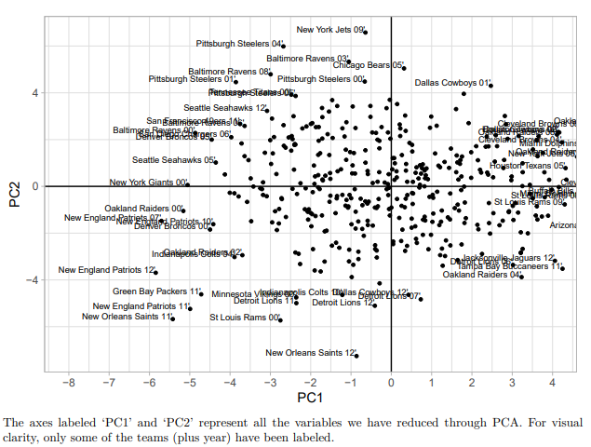
Analysis - Clustering
Every point represents the performance of a team in a certain season. A point further away from the origin means the team’s performance is more outstanding compare to the average. For example, the New England Patriots made to the Super Bowl in 2012 and its point is far away from the origin.
PC1 And PC2 are the reduced variables based on the predictors we use.

Slide 10
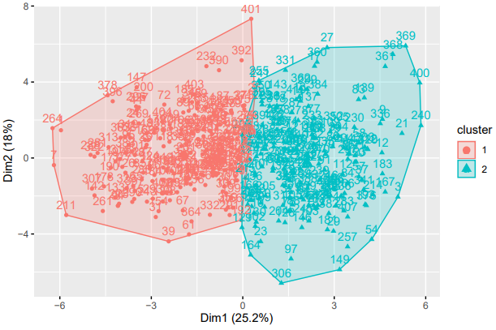
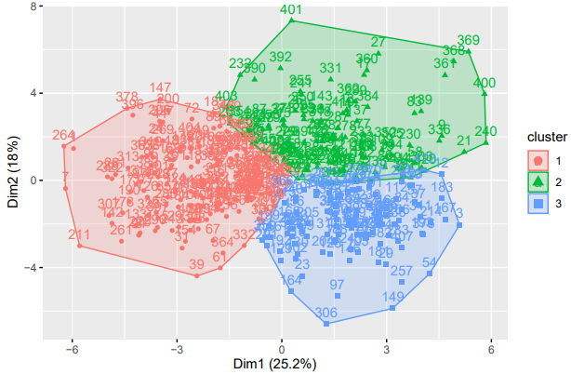
Analysis - Clustering
Using the K-Means Elbow Method, we found the ideal number of clusters to be 2. The figure on the left contains 2 clusters, which is the optimal number of clusters. Clusters represent the quality of teams based on collected input variables. According to the table (0 and 1 represent whether the team makes the playoff, 1 = yes), cluster 1 represents the non-playoff teams and cluster 2 are playoff caliber teams. Cluster 1 contained 5/215 = 2.32% of the playoff teams, while cluster 2 contained 75.4% of the playoff teams. This indicates that teams in cluster 2 were more than 30 times more likely to make the playoffs than cluster 1 teams. We also plot the figure that contains 3 clusters.

Slide 11
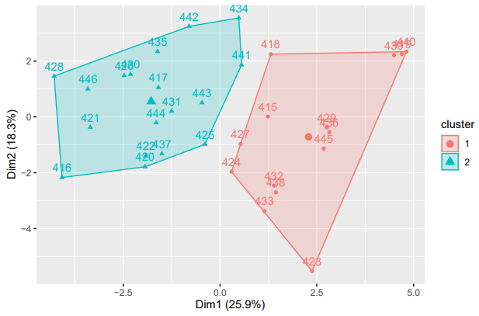
Analysis - Clustering
Lastly, we apply the K-Means algorithm to the 2013 season to predict its playoff teams, shown on the side.
The result demonstrates that Cluster 1 of our model predicts 79% of the teams correctly and does represent the playoff caliber teams. Cluster 2 yields a 5.5% of playoff team, showing that clustering really gives an accurate prediction on whether a team makes the NFL playoff based on its performance.

Slide 12
Thank you!

